Slide 1
Numerical Descriptive Measures

Slide 2
Learning Objectives
In this, you learn:
To describe the properties of central tendency, variation, and shape in numerical data
To calculate descriptive summary measures for a population
To calculate descriptive summary measures for a frequency distribution
To construct and interpret a boxplot
To calculate the covariance and the coefficient of correlation

Slide 3
Summary Definitions
The central tendency is the extent to which all the data values group around a typical or central value.
The variation is the amount of dispersion, or scattering, of values
The shape is the pattern of the distribution of values from the lowest value to the highest value.

Slide 4
Measures of Central Tendency: The Mean
The arithmetic mean (often just called “mean”) is the most common measure of central tendency
For a sample of size n:
Pronounced x-bar
The i^{th} value
Sample size
Observed values

Slide 5
Measures of Central Tendency: The Mean
(continued)
The most common measure of central tendency
Mean = sum of values divided by the number of values
Affected by extreme values (outliers)
0 1 2 3 4 5 6 7 8 9 10
0 1 2 3 4 5 6 7 8 9 10
Mean = 3
Mean = 4

Slide 6
Measures of Central Tendency: The Median
In an ordered array, the median is the “middle” number (50% above, 50% below)
Not affected by extreme values
0 1 2 3 4 5 6 7 8 9 10
0 1 2 3 4 5 6 7 8 9 10
Median = 3
Median = 3

Slide 7
Measures of Central Tendency: Locating the Median
The location of the median when the values are in numerical order (smallest to largest):
If the number of values is odd, the median is the middle number
If the number of values is even, the median is the average of the two middle numbers
Note that is not the value of the median, only the position of
the median in the ranked data

Slide 8
Measures of Central Tendency: The Mode
Value that occurs most often
Not affected by extreme values
Used for either numerical or categorical (nominal) data
There may may be no mode
There may be several modes
0 1 2 3 4 5 6 7 8 9 10 11 12 13 14
0 1 2 3 4 5 6
No Mode
Mode = 9

Slide 9
Measures of Central Tendency: Review Example
House Prices: $2,000,000
$500,000 $300,000 $100,000 $100,000
Sum $3,000,000
Mean: ($3,000,000/5)
= $600,000
Median: middle value of ranked data = $300,000
Mode: most frequent value = $100,000

Slide 10
Measures of Central Tendency: Which Measure to Choose?
The mean is generally used, unless extreme values (outliers) exist.
The median is often used, since the median is not sensitive to extreme values. For example, median home prices may be reported for a region; it is less sensitive to outliers.
In some situations it makes sense to report both the mean and the median.

Slide 11
Measures of Central Tendency: Summary
Central Tendency
Arithmetic Mean
Median
Mode
Geometric Mean
Middle value in the ordered array
Most frequently observed value
Rate of change of
a variable over time

Slide 12
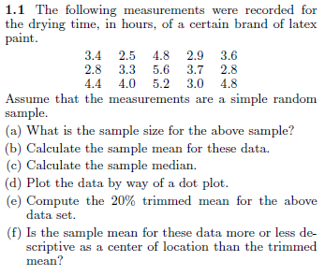

Slide 13
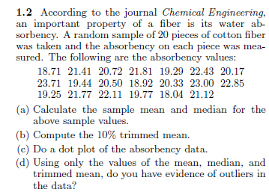

Slide 14
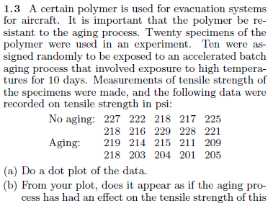
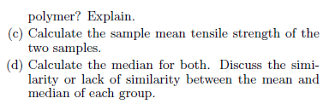

Slide 15
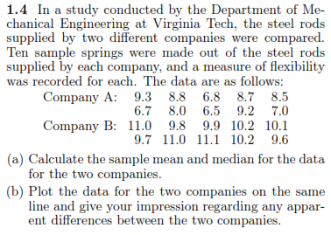

Slide 16
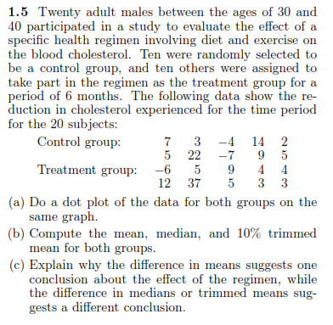

Slide 17
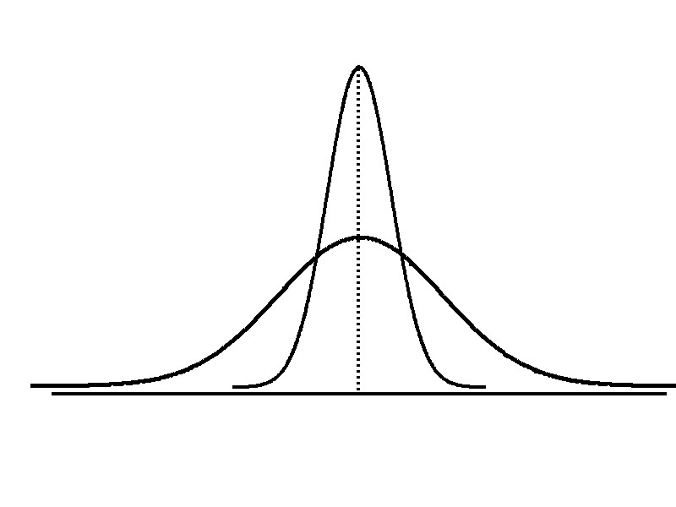
Measures of Variation
Variation
Range
Variance
Standard Deviation
Coefficient of Variation
Measures of variation give information on the spread or variability or dispersion of the data values.
Same center,
different variation

Slide 18
Measures of Variation: The Range
Simplest measure of variation
Difference between the largest and the smallest values:
Range = X_{largest} – X_{smallest}
Example:
0 1 2 3 4 5 6 7 8 9 10 11 12 13 14
Range = 13 - 1 = 12

Slide 19
Measures of Variation: Why The Range Can Be Misleading
Ignores the way in which data are distributed
Sensitive to outliers
7 8 9 10 11 12
7 8 9 10 11 12
Range = 12 - 7 = 5
Range = 12 - 7 = 5
1,1,1,1,1,1,1,1,1,1,1,2,2,2,2,2,2,2,2,3,3,3,3,4,5
Range = 5 - 1 = 4
1,1,1,1,1,1,1,1,1,1,1,2,2,2,2,2,2,2,2,3,3,3,3,4,120
Range = 120 - 1 = 119

Slide 20
Measures of Variation: The Variance
Average (approximately) of squared deviations of values from the mean
Sample variance:
Where
= arithmetic mean
n = sample size
X_{i} = i^{th} value of the variable X

Slide 21
Measures of Variation: The Standard Deviation
Most commonly used measure of variation
Shows variation about the mean
Is the square root of the variance
Has the same units as the original data
Sample standard deviation:

Slide 22
Measures of Variation: The Standard Deviation
Steps for Computing Standard Deviation
1. Compute the difference between each value and the mean.
2. Square each difference.
3. Add the squared differences.
4. Divide this total by n-1 to get the sample variance.
5. Take the square root of the sample variance to get the sample standard deviation.

Slide 23
Measures of Variation: Sample Standard Deviation: Calculation Example
Sample Data (X_{i}) : 10 12 14 15 17 18 18 24
n = 8 Mean = X = 16
A measure of the “average” scatter around the mean

Slide 24
Measures of Variation: Comparing Standard Deviations
Data A
Mean = 15.5
S = 3.338
11 12 13 14 15 16 17 18 19 20 21
Data B
Mean = 15.5
S = 0.926
11 12 13 14 15 16 17 18 19 20 21
Data C
Mean = 15.5
S = 4.570
11 12 13 14 15 16 17 18 19 20 21

Slide 25
Measures of Variation: Comparing Standard Deviations
Smaller standard deviation
Larger standard deviation

Slide 26
Measures of Variation: Summary Characteristics
The more the data are spread out, the greater the range, variance, and standard deviation.
The more the data are concentrated, the smaller the range, variance, and standard deviation.
If the values are all the same (no variation), all these measures will be zero.
None of these measures are ever negative.

Slide 27
Measures of Variation: The Coefficient of Variation
Measures relative variation
Always in percentage (%)
Shows variation relative to mean
Can be used to compare the variability of two or more sets of data measured in different units

Slide 28
Measures of Variation: Comparing Coefficients of Variation
Stock A:
Average price last year = $50
Standard deviation = $5
Stock B:
Average price last year = $100
Standard deviation = $5
Both stocks have the same standard deviation, but stock B is less variable relative to its price

Slide 29
Shape of a Distribution
Describes how data are distributed
Measures of shape
Symmetric or skewed
Left-Skewed
Symmetric
Right-Skewed
Mean < Median
Mean = Median
Median < Mean

Slide 30
Numerical Descriptive Measures for a Population
Descriptive statistics discussed previously described a sample, not the population.
Summary measures describing a population, called parameters, are denoted with Greek letters.
Important population parameters are the population mean, variance, and standard deviation.

Slide 31
Numerical Descriptive Measures for a Population: The mean µ
The population mean is the sum of the values in the population divided by the population size, N
Where
μ = population mean
N = population size
X_{i} = i^{th} value of the variable X

Slide 32
Numerical Descriptive Measures For A Population: The Variance σ²
Average of squared deviations of values from the mean
Population variance:
Where
μ = population mean
N = population size
X_{i} = i^{th} value of the variable X

Slide 33
Numerical Descriptive Measures For A Population: The Standard Deviation σ
Most commonly used measure of variation
Shows variation about the mean
Is the square root of the population variance
Has the same units as the original data
Population standard deviation:

Slide 34
Sample statistics versus population parameters
Measure | Population Parameter | Sample Statistic
Mean
Variance
Standard Deviation

Slide 35
Computing Numerical Descriptive Measures From A Frequency Distribution
Sometimes you have only a frequency distribution, not the raw data.
In this situation you can compute approximations to the mean and the standard deviation of the data

Slide 36
Approximating the Mean from a Frequency Distribution
Use the midpoint of a class interval to approximate the values in that class
Where n = number of values or sample size
c = number of classes in the frequency distribution
m_{j} = midpoint of the j^{th} class
f_{j} = number of values in the j^{th} class

Slide 37
Approximating the Standard Deviation from a Frequency Distribution
Assume that all values within each class interval are located at the midpoint of the class
Where n = number of values or sample size
c = number of classes in the frequency distribution
m_{j} = midpoint of the j^{th} class
f_{j} = number of values in the j^{th} class

Slide 38
Quartile Measures
Quartiles split the ranked data into 4 segments with an equal number of values per segment
25%
25%
25%
25%
Q1
Q2
Q3
The first quartile, Q₁, is the value for which 25% of the observations are smaller and 75% are larger
Q₂ is the same as the median (50% of the observations are smaller and 50% are larger)
Only 25% of the observations are greater than the third quartile

Slide 39
Quartile Measures: Locating Quartiles
Find a quartile by determining the value in the appropriate position in the ranked data, where
First quartile position: Q₁ = (n+1)/4 ranked value
Second quartile position: Q₂ = 2(n+1)/4 ranked value
Third quartile position: Q₃ = 3(n+1)/4 ranked value
where n is the number of observed values

Slide 40
Quartile Measures: Calculation Rules
When calculating the ranked position use the following rules
If the result is a whole number then it is the ranked position to use
If the result is a fractional half (e.g. 2.5, 7.5, 8.5, etc.) then average the two corresponding data values.
If the result is not a whole number or a fractional half then round the result to the nearest integer to find the ranked position.

Slide 41
Quartile Measures: Locating Quartiles
Sample Data in Ordered Array: 11 12 13 16 16 17 18 21 22
(n = 9)
Q₁ is in the (9+1)/4 = 2.5 position of the ranked data
so use the value half way between the 2nd and 3rd values,
so Q₁ = 12.5
Q₁ and Q₃ are measures of non-central location
Q₂ = median, is a measure of central tendency

Slide 42
Quartile Measures Calculating The Quartiles: Example
Sample Data in Ordered Array: 11 12 13 16 16 17 18 21 22
(n = 9)
Q₁ is in the (9+1)/4 = 2.5 position of the ranked data,
so Q₁ = (12+13)/2 = 12.5
Q₂ is in the (9+1)/2 = 5th position of the ranked data,
so Q₂ = median = 16
Q₃ is in the 3(9+1)/4 = 7.5 position of the ranked data,
so Q₃ = (18+21)/2 = 19.5
Q₁ and Q₃ are measures of non-central location
Q₂ = median, is a measure of central tendency

Slide 43
Quartile Measures: The Interquartile Range (IQR)
The IQR is Q₃ – Q₁ and measures the spread in the middle 50% of the data
The IQR is also called the midspread because it covers the middle 50% of the data
The IQR is a measure of variability that is not influenced by outliers or extreme values
Measures like Q₁, Q₃, and IQR that are not influenced by outliers are called resistant measures

Slide 44
Calculating The Interquartile Range
Example:
Median
(Q₂)
X
X
Q₁
Q₃
minimum
maximum
25% 25% 25% 25%
12 30 45 57 70
Interquartile range
= 57 – 30 = 27

Slide 45
The Five Number Summary
The five numbers that help describe the center, spread and shape of data are:
X_{smallest}
First Quartile (Q₁)
Median (Q₂)
Third Quartile (Q₃)
X_{largest}

Slide 46
Relationships among the five-number summary and distribution shape
Left-Skewed | Symmetric | Right-Skewed
Median – X_{smallest} > X_{largest} – Median | Median – X_{smallest} ≈ X_{largest} – Median | Median – X_{smallest} < X_{largest} – Median
Q₁ – X_{smallest} > X_{largest} – Q₃ | Q₁ – X_{smallest} ≈ X_{largest} – Q₃ | Q₁ – X_{smallest} < X_{largest} – Q₃
Median – Q₁ > Q₃ – Median | Median – Q₁ ≈ Q₃ – Median | Median – Q₁ < Q₃ – Median

Slide 47
Five Number Summary and The Boxplot
The Boxplot: A Graphical display of the data based on the five-number summary:
X_{smallest} -- Q₁ -- Median -- Q₃ -- X_{largest}
Example:
25% of data 25% 25% 25% of data
of data of data
X_{smallest} Q₁ Median Q₃ X_{largest}

Slide 48
Five Number Summary: Shape of Boxplots
If data are symmetric around the median then the box and central line are centered between the endpoints
A Boxplot can be shown in either a vertical or horizontal orientation
X_{smallest} Q₁ Median Q₃ X_{largest}

Slide 49
Distribution Shape and The Boxplot
Left-Skewed
Symmetric
Right-Skewed
Q₁
Q₂
Q₃
Q₁
Q₂
Q₃
Q₁
Q₂
Q₃

Slide 50
Boxplot Example
Below is a Boxplot for the following data:
0 2 2 2 3 3 4 5 5 9 27
The data are right skewed, as the plot depicts
X_{smallest} Q₁ Q₂ Q₃ X_{largest}
0 2 3 5 27

Slide 51
Boxplot example showing an outlier
The boxplot below of the same data shows the outlier value of 27 plotted separately
A value is considered an outlier if it is more than 1.5 times the interquartile range below Q₁ or above Q₃

Slide 52
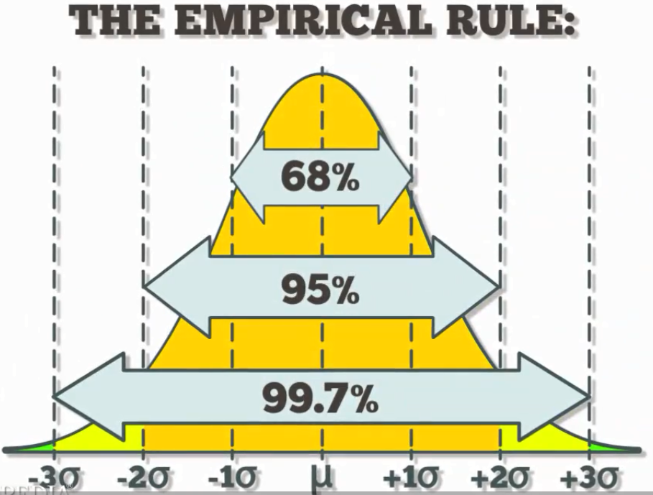

Slide 53
Chapter Summary
Described measures of central tendency
Mean, median, mode, geometric mean
Described measures of variation
Range, interquartile range, variance and standard deviation, coefficient of variation, Z-scores
Illustrated shape of distribution
Symmetric, skewed
Described data using the 5-number summary
Boxplots

Slide 54
Chapter Summary
(continued)
Discussed covariance

